Slide 1
Traditional Healing Practices and Their Integration with Modern Health Technologies
Enhancing Health Outcomes Through Cultural and Technological Synergy
KAMALI KINUTHIA
C025-01-0639/2020

Slide 2
INTRODUCTION
Overview of Traditional Healing Practices
African herbal medicine is a traditional healing system that utilizes a wide variety of plants, herbs and natural substances to treat ailments and promote health
Relevance to Modern Health Technologies
Integrating traditional healing practices with modern health technologies can enhance healthcare delivery and outcomes.

Slide 3
MORINGA INTEGRATION
Traditional Herbal Medicine: Moringa
Historical Use
Overview: Traditional uses of Moringa for treating malnutrition, anemia, and various infections.
Examples: Preparation of Moringa leaves in teas, powders, and topical treatments.
Cultural Significance
Importance: Moringa's role in traditional medicine across African communities includes treating malnutrition and anaemia.

Slide 4
MODERN INTEGRATION
Digital Health Records and Herbal Databases
Example: Creation of an online database documenting Moringa's medicinal uses, preparation methods, and clinical studies.
Impact: Improved access for researchers and healthcare providers to traditional knowledge.
Health Apps and Educational Platforms
Example: Development of a mobile app providing information about Moringa’s health benefits, dosage recommendations, and integration with modern treatments.
Impact: Increased public awareness and accessibility to traditional remedies.
Telemedicine and Collaborative Platforms
Example: Use of telemedicine to connect traditional healers with modern healthcare practitioners for collaborative treatment plans involving Moringa.
Impact: Holistic care that combines traditional remedies with conventional treatments.

Slide 5
BENEFITS OF INTEGRATION
Enhanced Health Outcomes
Combining traditional Moringa treatments with modern health technologies for better management of nutrition and disease prevention.
Research and Validation
Opportunities for scientific validation of Moringa’s traditional uses and incorporation into evidence-based medicine.
Cultural Preservation and Innovation
Respecting and preserving traditional knowledge while integrating it with modern health innovations for improved patient care.

Slide 6
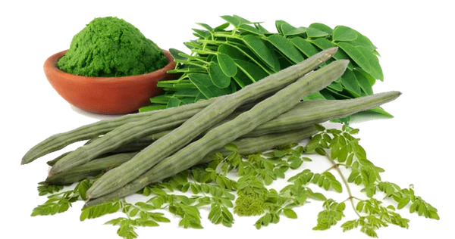
VISUAL EXAMPLES
Moringa plant in different forms

Slide 7
CHALLENGES AND CONSIDERATIONS
Cultural Sensitivity
Ensuring the integration of Moringa respects traditional practices and cultural values.
Standardization and Validation
Challenges in standardizing Moringa’s traditional uses and validating them through
scientific research.
Access and Training
Providing adequate resources and training for both traditional healers and modern healthcare
professionals to effectively use Moringa in patient care.

